Slide 1
PromptCast: A New Prompt-based Learning Paradigm for Time Series Forecasting
IEEE Transactions on Knowledge and Data Engineering
Oct 2023
Hao Xue, Flora D. Salim
School of Computer Science and Engineering,
University of New South Wales, Sydney, Australia
2024/2/1

Slide 2

Abstract
Part I
This paper presents a new perspective on time series forecasting.
2. In existing time series forecasting methods, the models take a sequence of numerical values as input and yield numerical values as output. The existing SOTA models are largely based on the Transformer architecture, modified with multiple encoding mechanisms to incorporate the context and semantics around the historical data.
3. Inspired by the successes of pre-trained language foundation models, we pose a question about whether these models can also be adapted to solve timeseries forecasting. Thus, we propose a new forecasting paradigm: prompt-based time series forecasting (PromptCast). In this novel task, the numerical input and output are transformed into prompts and the forecasting task is framed in a sentence-tosentence manner, making it possible to directly apply language models for forecasting purposes.
4. To support and facilitate the research of this task, we also present a large-scale dataset (PISA) that includes three real-world forecasting scenarios. We evaluate different SOTA numerical-based forecasting methods and language generation models. The benchmark results with various forecasting settings demonstrate the proposed PromptCast with language generation models is a promising research direction. Additionally, in comparison to conventional numerical-based forecasting, PromptCast shows a much better generalization ability under the zero-shot setting.

Slide 3

I. INTRODUCTION
Part I
Time series forecasting is a research-intensive field, especially with the increasing of applying various deep learning frameworks for prediction such as models based on LSTM [1], Temporal Convolutional Network (TCN) [2], and Transformer [3]. More recently, we are witnessing a fast growth of large-scale pre-trained models in the Natural Language Processing (NLP) field. These models, also known as foundation models [4], are often pre-trained with an extremely large amount of data and have demonstrated good performance across various downstream tasks. For example, BERT [5] can be adapted for multiple NLP tasks, CLIP [6] and GLIP [7] are good at CV tasks. However, we also notice that this evolution seems mostly limited to the NLP and CV fields.
Hence, we are particularly interested in exploring the research question of whether we can take advantage of large-scale pre-trained foundation models and adapt these models for predicting time series. To investigate this question, in this paper, we formally introduce a novel task: prompt-based time series forecasting (PromptCast). The existing forecasting methods including the state-of-the-art Transformer-based forecasting models [8], [9], [10], [11], [12], [13] can be simplified as a numerical forecasting paradigm as shown in Figure 1 (a). Numerical forecasting methods always take numerical values as input and generate numerical values as the prediction for the next time step. Instead, the input and output of the proposed prompt-based forecasting (Figure 1 (b)) are natural language sentences. This paradigm change enables the utilization of language generation models for forecasting.

Slide 4
I. INTRODUCTION
Part I
This new forecasting paradigm is beneficial in multiple aspects.
PromptCast presents a novel “code less” solution for time series forecasting, which could provide a new perspective rather than purely focusing on designing more and more complicated deep learning forecasting models (e.g., Transformerbased Informer, Autoformer, and FEDformer). It also becomes a relatively easy-accessible and user-friendly method for nonresearcher users, compared to existing forecasting models that require many tedious parameter searching and training processes, especially under a new forecasting scenario.
As pointed out in a recent research [14], the benefits of using a single neural model across different tasks are significant. The PromptCast task explores the potential of using language foundation models for the forecasting task which could make it possible to broaden the language models beyond the realm of typical text-based tasks.

Slide 5
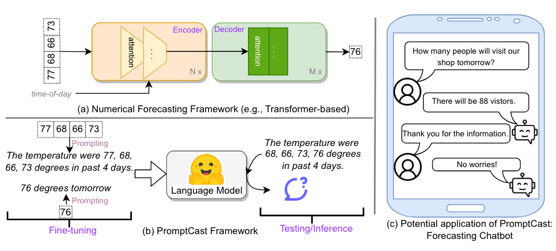
I. INTRODUCTION
Part I
Fig. 1. Conceptual illustrations of: (a) the typical framework of existing numerical-based forecasting method; (b) the framework of the proposed PromptCast; (c) a potential forecasting chatbot application based on PromptCast.

Slide 6
I. INTRODUCTION
In summary, our contributions are three-fold:
(1) We propose a novel prompt-based forecasting paradigm, which differs from the existing forecasting methods. This is the first time the general time series forecasting problem is addressed in a natural language generation manner.
(2) We release a large-scale dataset (PISA) with 311,932 data instances in total for the newly introduced task. The dataset covers diverse time series forecasting scenarios.
(3) We develop a benchmark (our data and codes for the benchmark are available at https:// github.com/HaoUNSW/PISA) on the proposed PISA datasets. It evaluates the state-of-the-art numerical-based forecasting methods and popular language generation models.
Part I

Slide 7
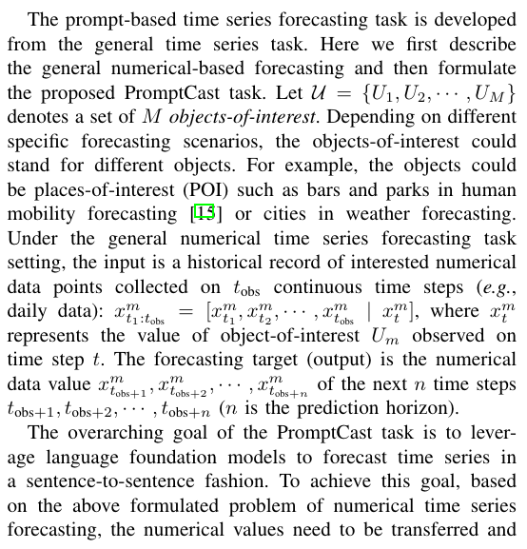
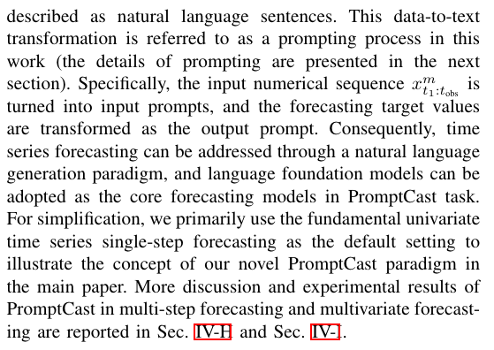

II. PROMPT-BASED TIME SERIES FORECASTING
Part I

Slide 8
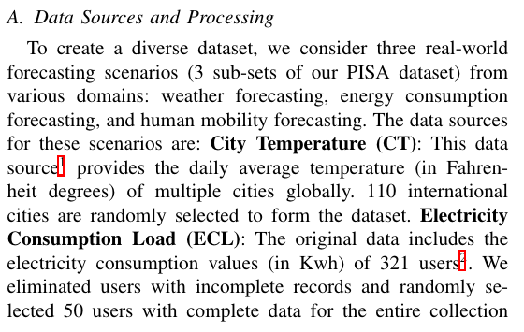
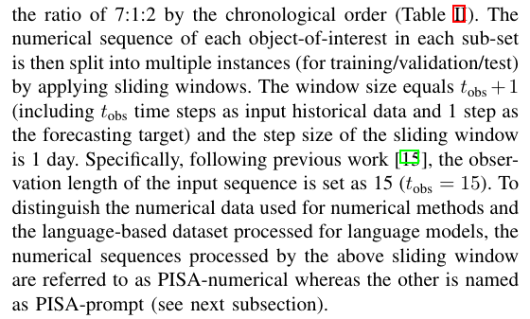
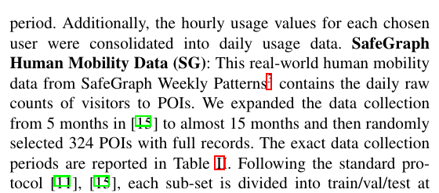

III. DATASET DESIGN AND DESCRIPTION
Part I

Slide 9
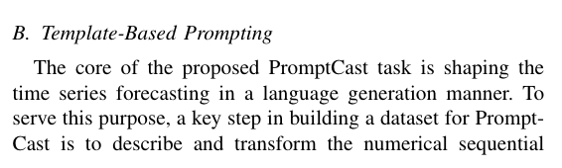
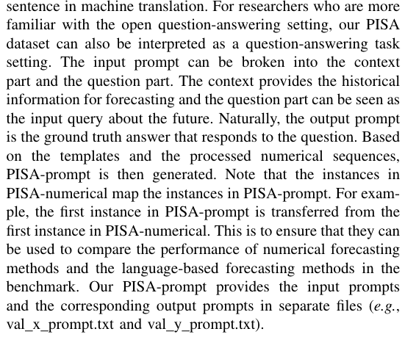
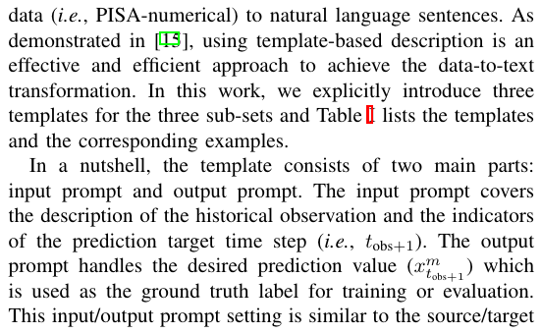

III. DATASET DESIGN AND DESCRIPTION
Part I

Slide 10
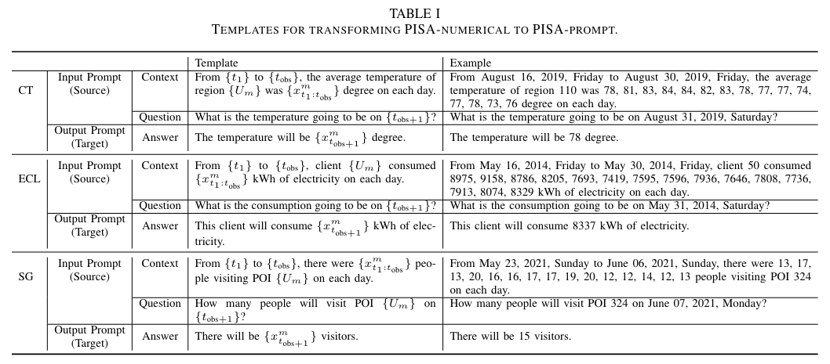
III. DATASET DESIGN AND DESCRIPTION
Part I

Slide 11
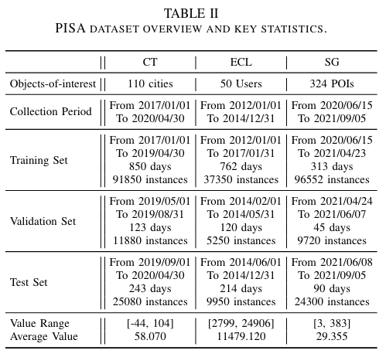
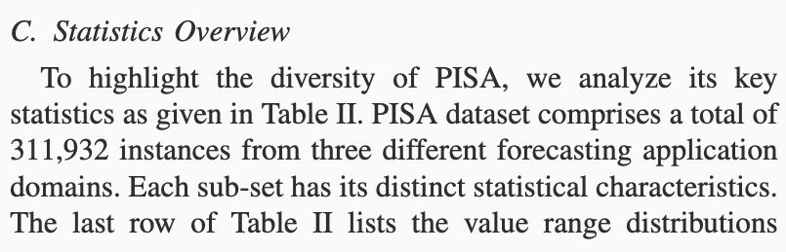
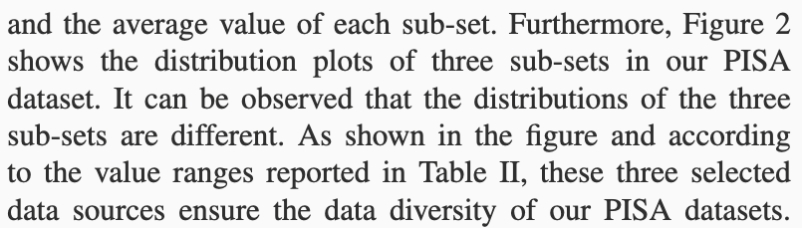

III. DATASET DESIGN AND DESCRIPTION
Part I

Slide 12
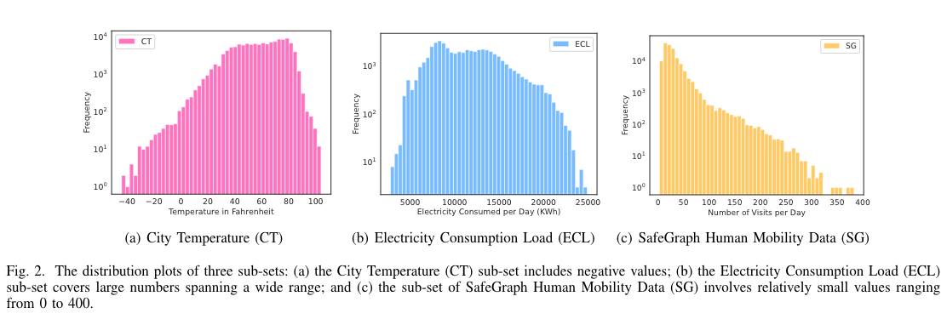
III. DATASET DESIGN AND DESCRIPTION
Part I

Slide 13
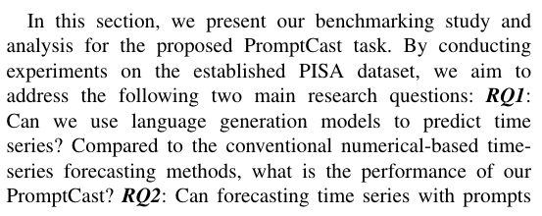
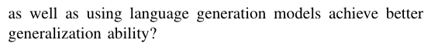
IV. BENCHMARK
Part I
A. Evaluation Metrics
B. Baselines
C. Implementation Details
D. Experimental Performance
E. Training From Scratch
F. Zero-shot Performance
G. Prompts Ablation Study
H. Multi-step Forecasting
I. Multivariate Time Series Forecasting

Slide 14
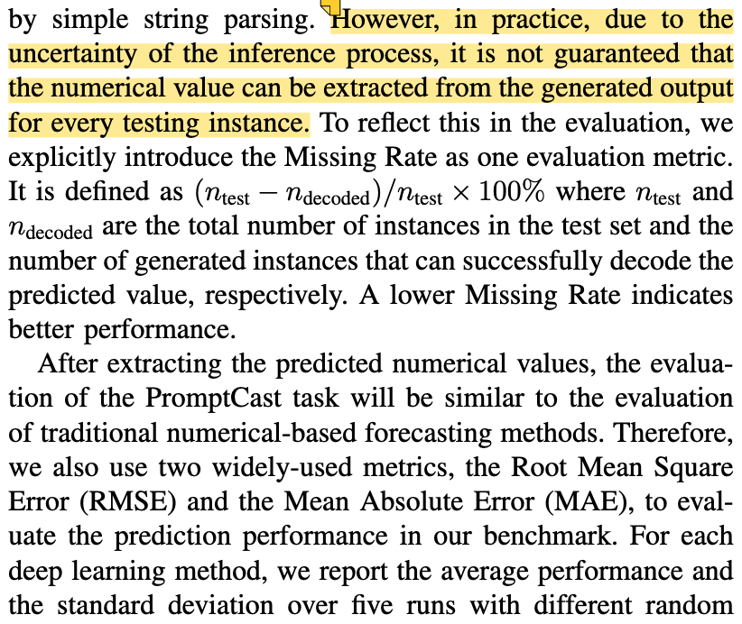
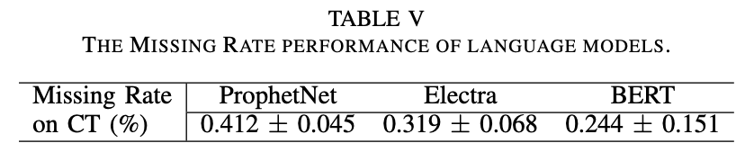
A. Evaluation Metrics
Part I

Slide 15
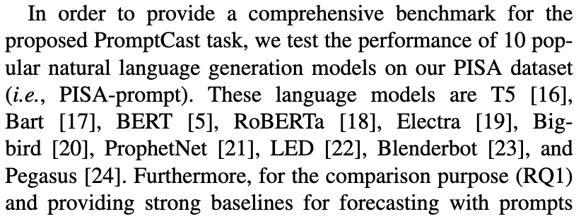
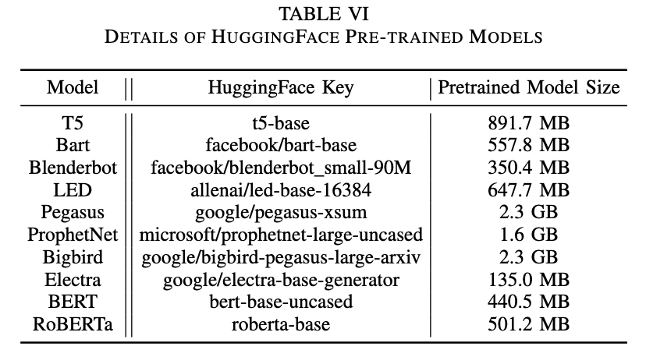
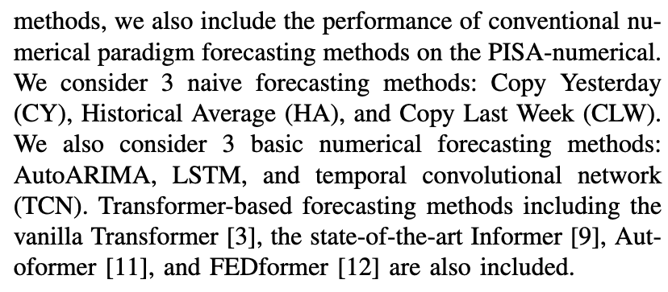
B. Baselines
Part I

Slide 16
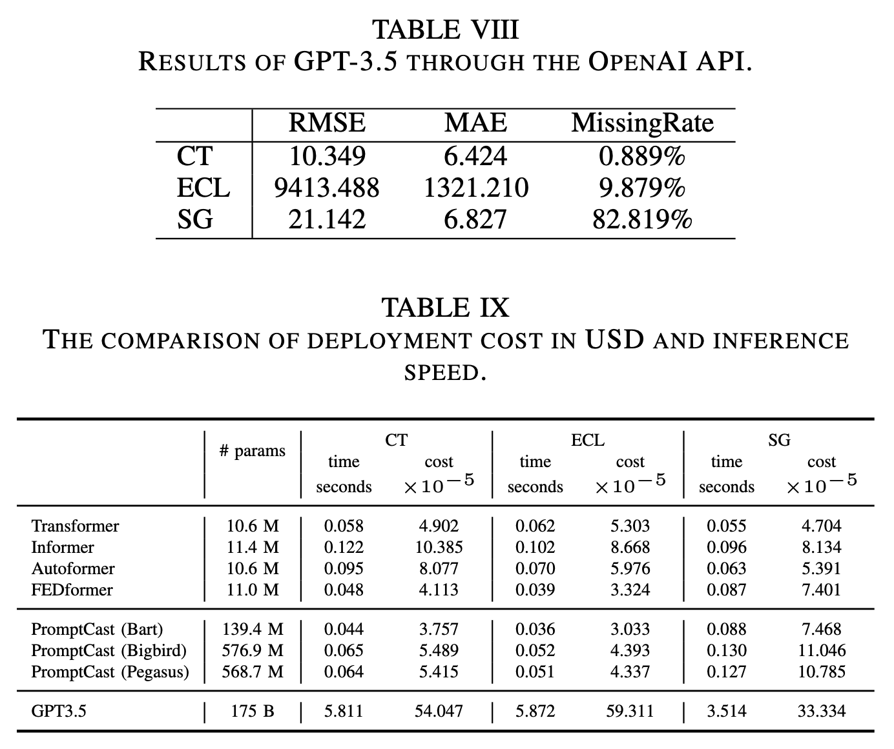
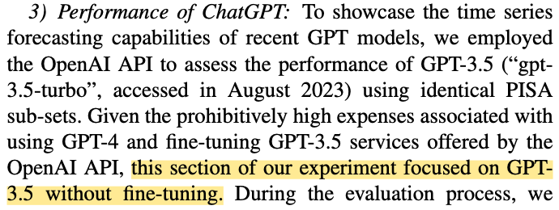
C & D：Experimental Performance
Part I

Slide 17
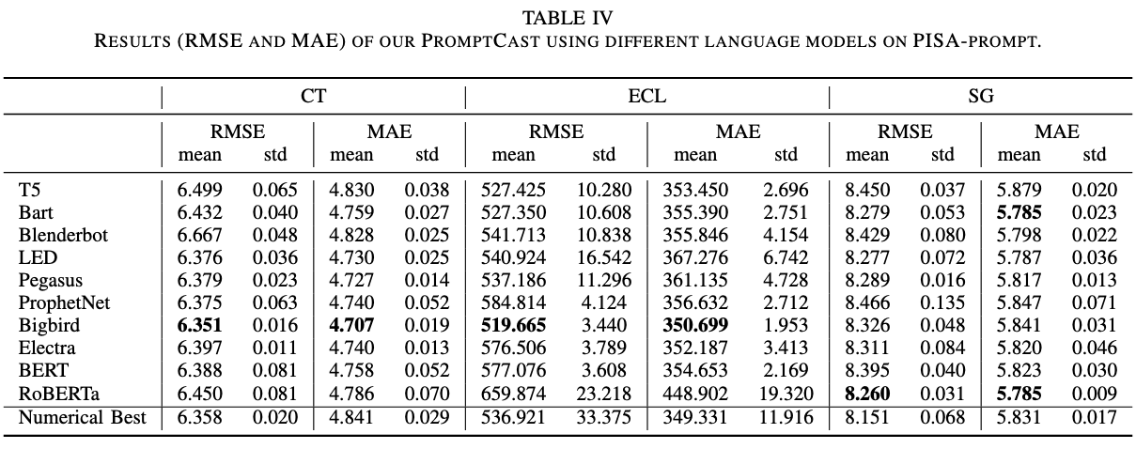
C & D：Experimental Performance
Part I

Slide 18
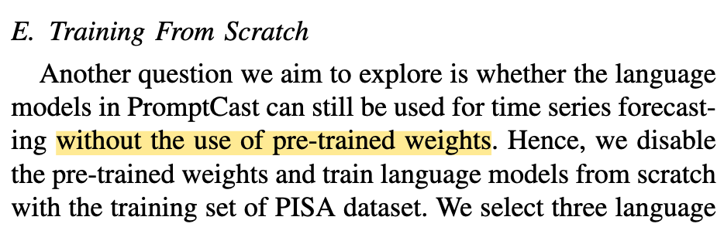
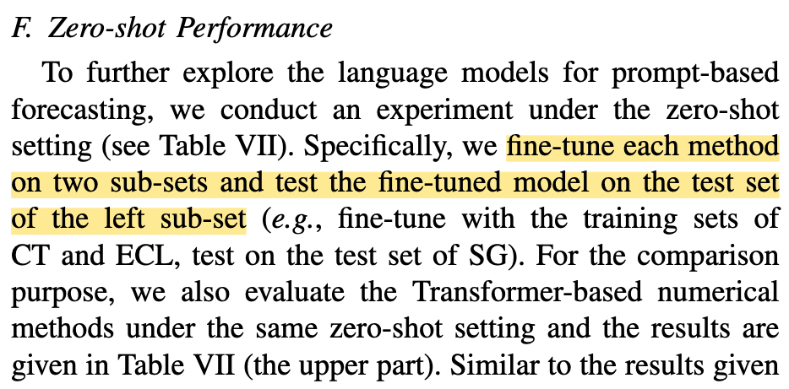

E & F：Scrath & Zero-shot
Part I

Slide 19
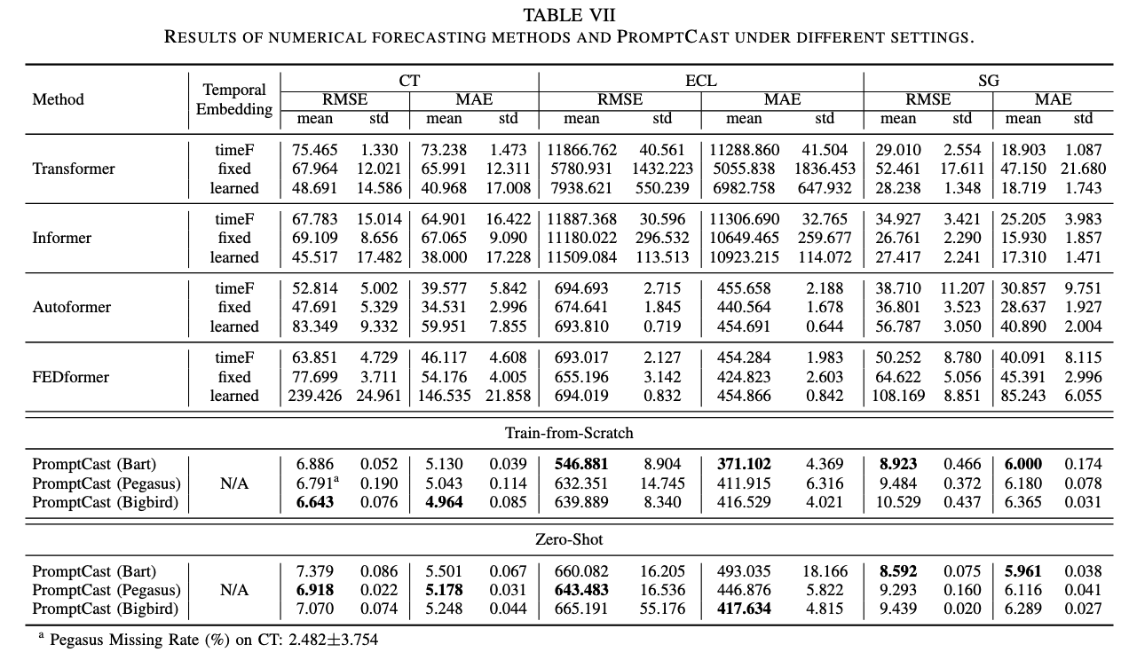
E & F
Part I

Slide 20
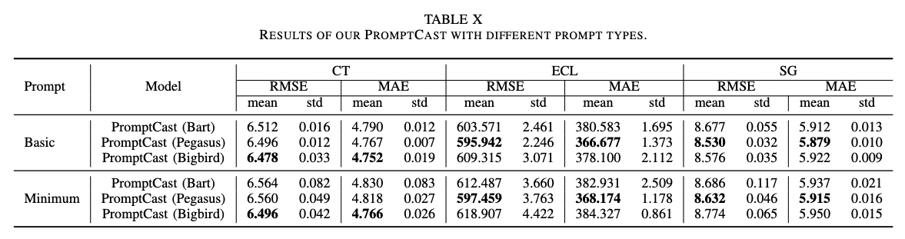
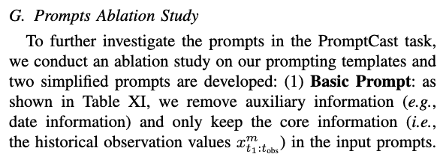
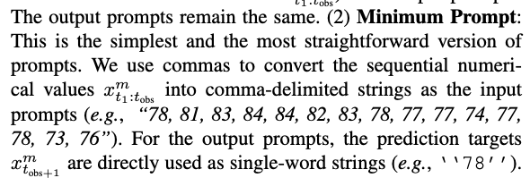
E & F
Part I

Slide 21
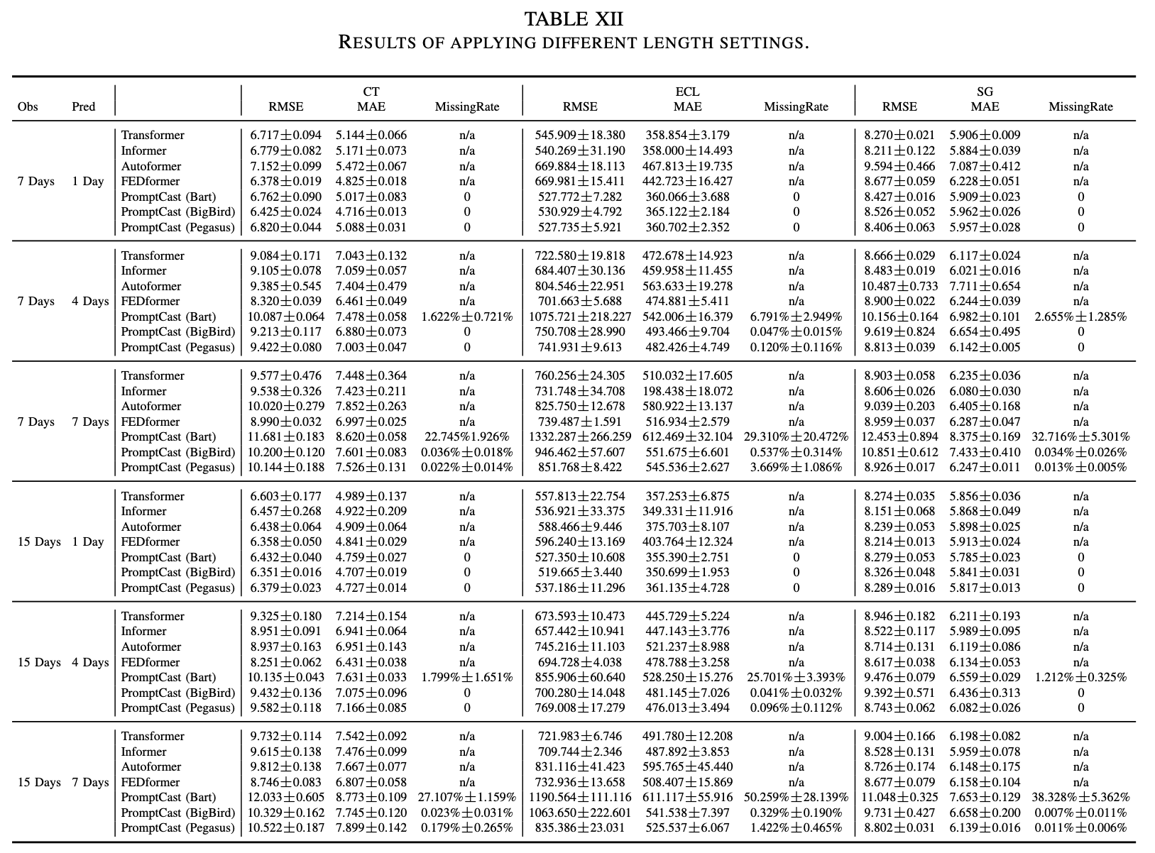
H. Multi-step Forecasting
Part I

Slide 22
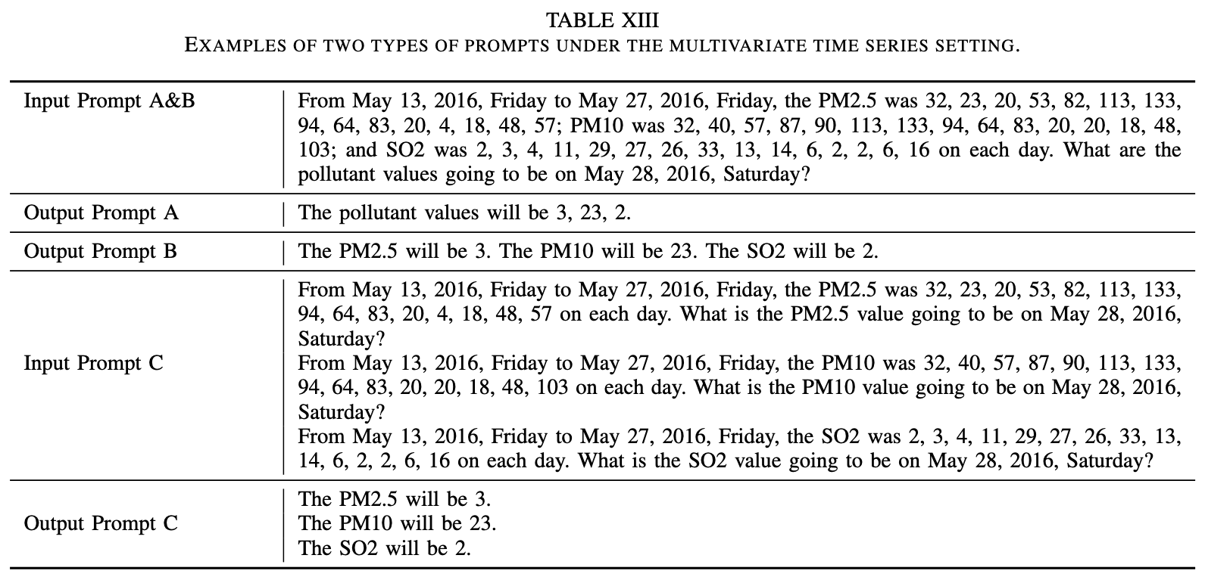
I. Multivariate Time Series Forecasting
Part I

Slide 23
I. Multivariate Time Series Forecasting
Part I

Slide 24
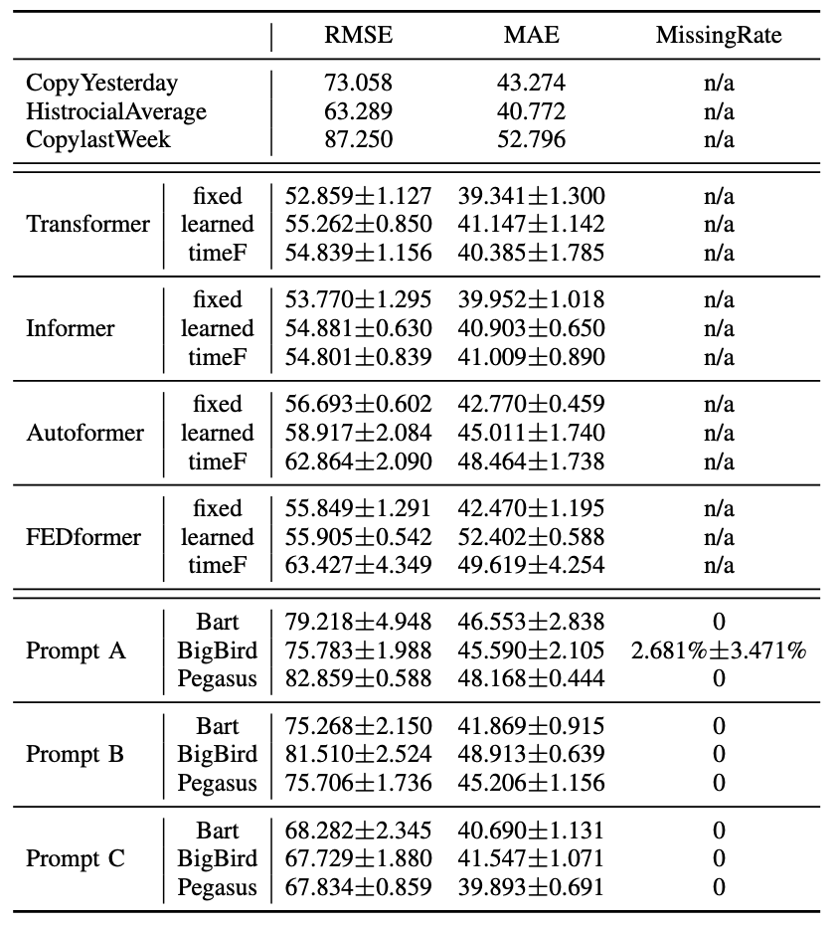
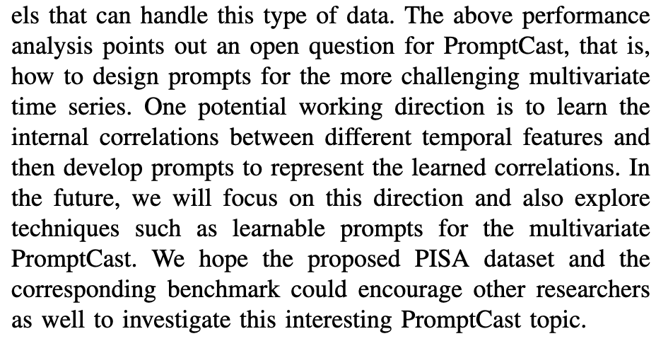
I. Multivariate Time Series Forecasting
Part I
Open Question and Future Work.

Slide 25
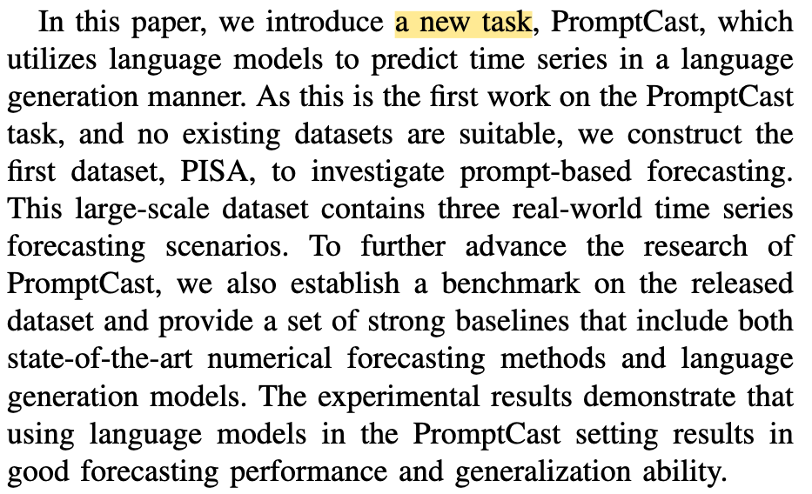
VI. DISCUSSION AND CONCLUSION
Part I

Slide 26
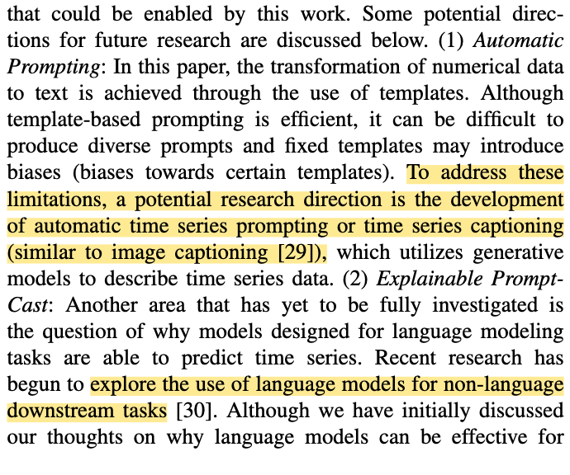
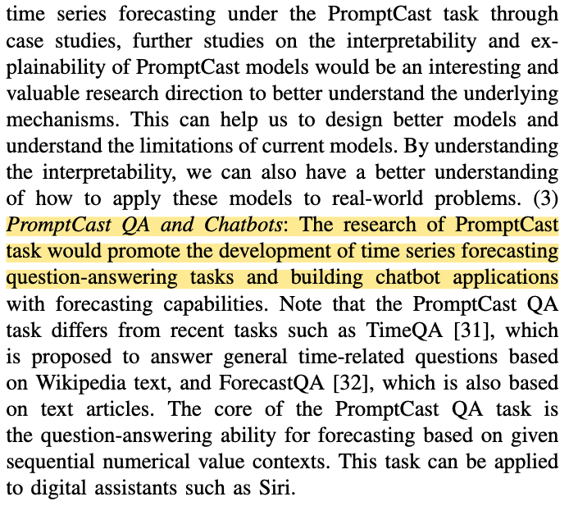
VI. DISCUSSION AND CONCLUSION
Part I

Slide 27
VI. DISCUSSION AND CONCLUSION
Part I

Slide 28
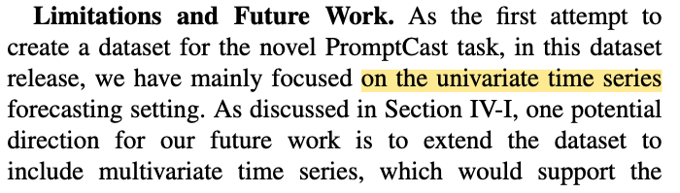
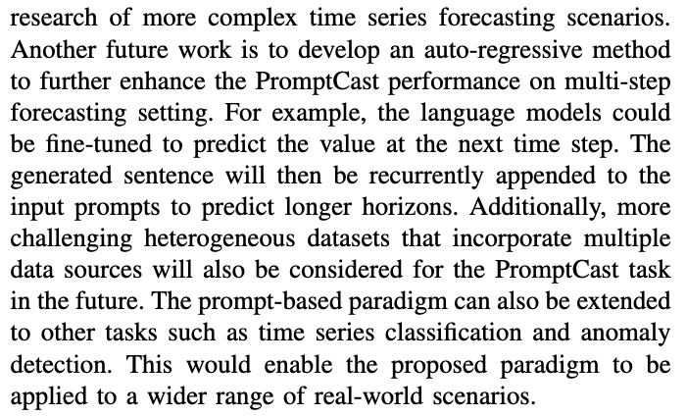
VI. DISCUSSION AND CONCLUSION
Part I

Slide 29
Many thanks!
汇报人：周振坤
2024/2/1

